Slide 1
Trash Classifier
Prerana Samant
Zeal Patel
Ashish Pant
Shufeng Li

Slide 2
Introduction
Waste management is critical to maintain proper hygiene in our surrounding. Recycling is important to prevent the elements like plastic from deteriorating the environment.
Waste is sorted into proper categories
Organic waste
Recyclable waste
This project will have two aspects.
The first feature will distinguish between the type of garbage after scanning the object
the second feature will detect when the garbage bin is full and send an indication to the centralized garbage management system.

Slide 3
Objective
Implement a smart trash detector to build a basic model to sort the trash into just two categories. Based on the type of trash it will detect the type : 1. Recycle 2. Organic
Based on input from camera, it will open the respective lid based on type.
To detect if the bin is full and send the message from Node MCU to Raspberry Pi. Raspberry Pi will further send message to app.

Slide 4
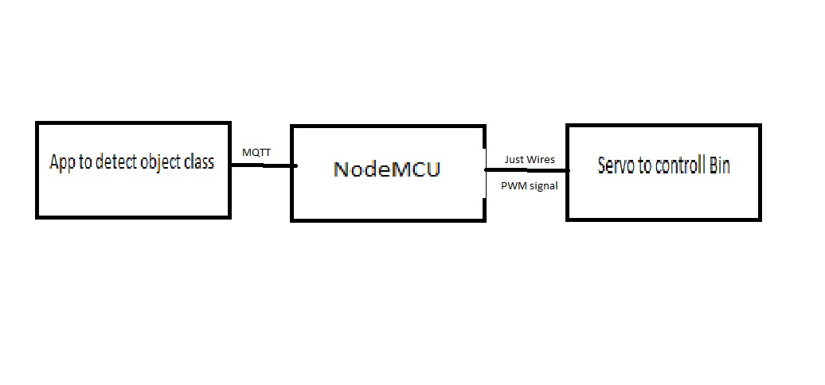
Block Diagram

Slide 5
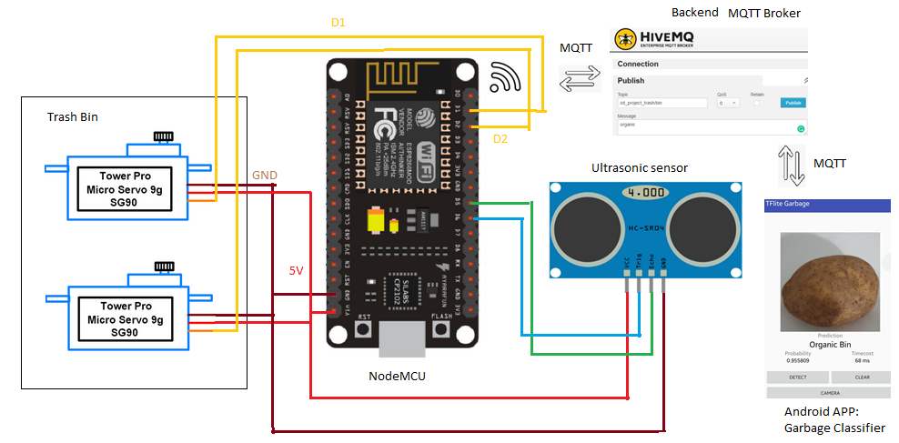
Circuit Diagram

Slide 6
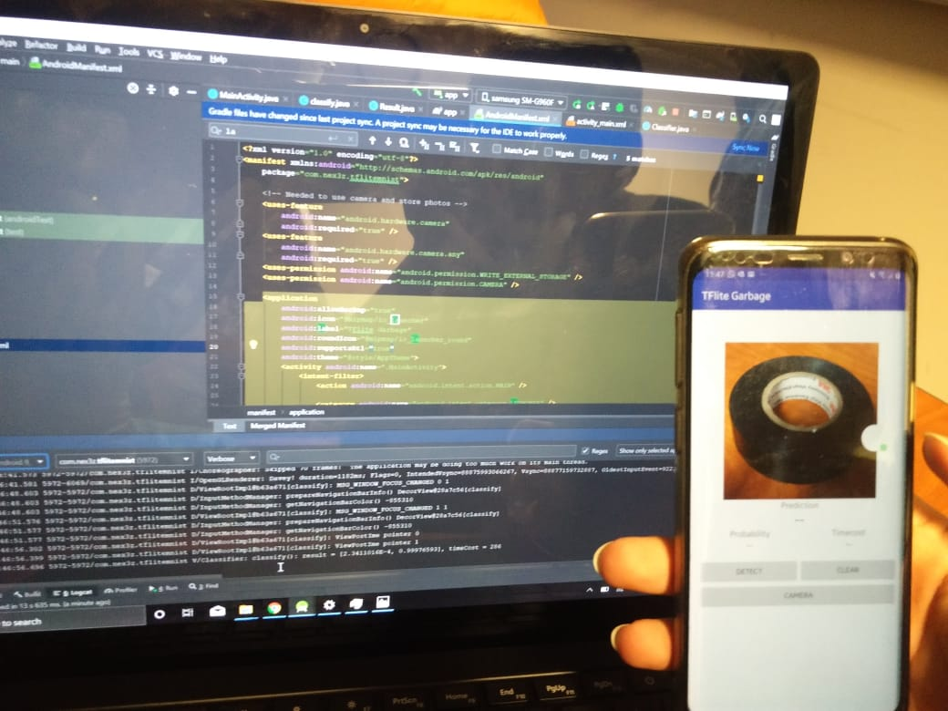
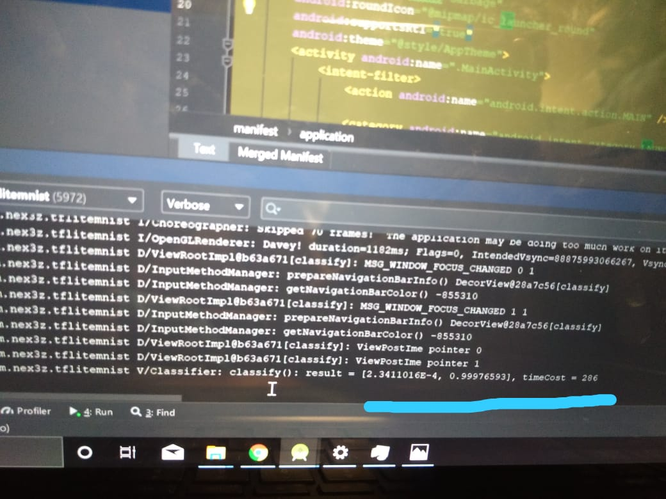
Results for- Trash Classification Recycle
Deep learning results
Result 99% for insulation tape

Slide 7
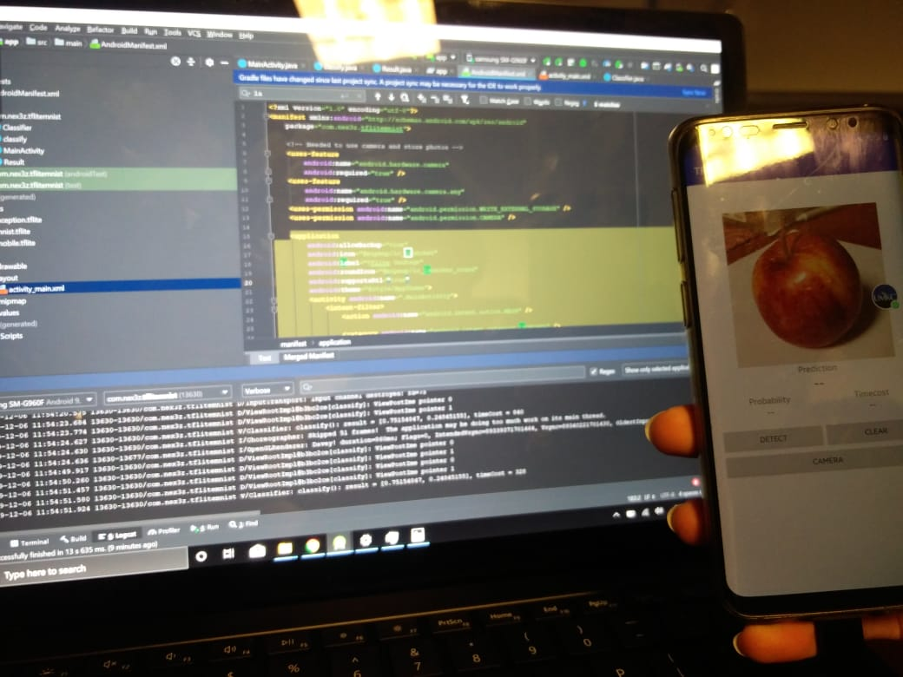
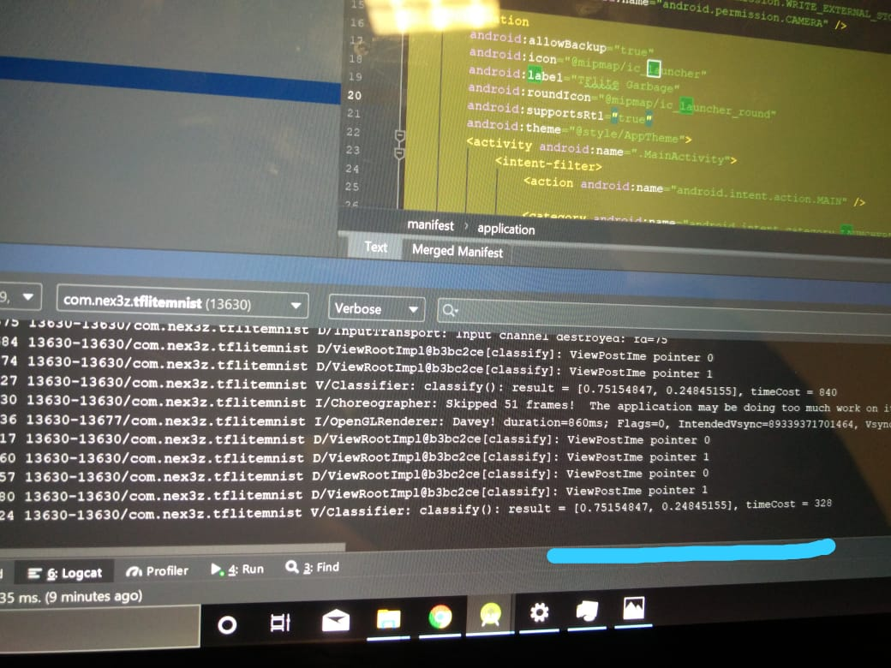
Results for- Trash Classification Organic
Deep learning results
Result 75% for Organic-Apple

Slide 8
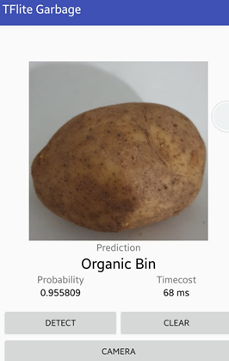
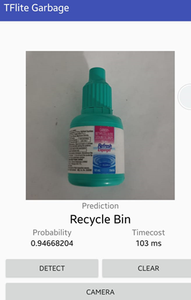
Results for- Trash Classification on APP
Result 94% for Recycle-Plastic bottle
Result 95% for Organic-Potato

Slide 9
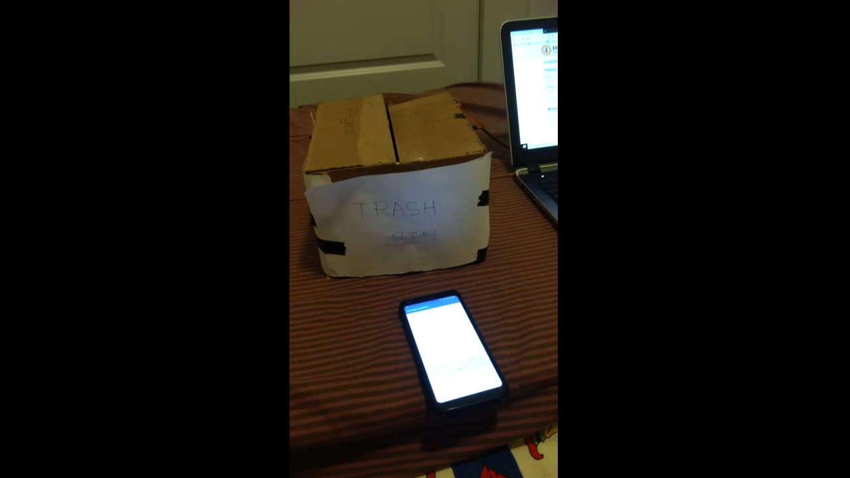
Demo

Slide 10
Things to be Done further
Implement same trained model in raspberry pi using python to detect object from fixed camera to open bin accordingly.
Aesthetically improve the trash bin with proper mounting of servos and opening mechanism

Slide 11
Thank You! Questions?

